Slide 1
Data Analyst Portfolio
Oge

Slide 2
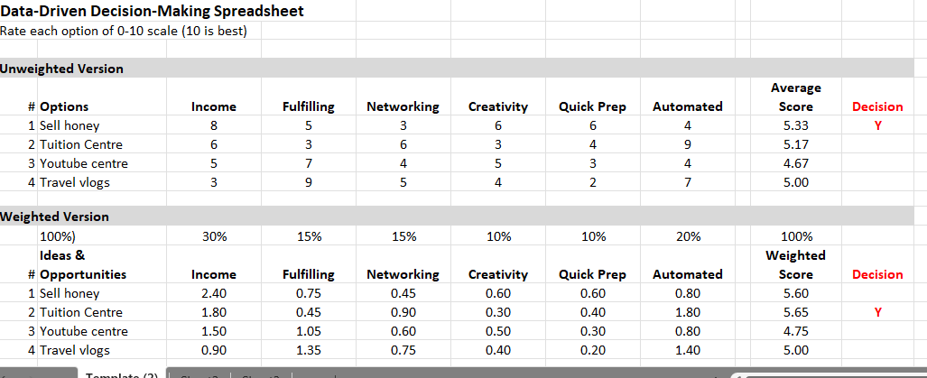
Using Google Sheets to display data-driven decision-making

